Slide 1

Automatic Modulation Classification
AA1505 - M.T.Ahamed
AA1394 – W.K.V.Lowe

Slide 2
Table of contents
01
02
03
04
Problem Statement
Methodology
Implementation
Risk Factors
05
Timeline

Slide 3

Problem Statement
01
Identifying the modulation scheme used in a wireless communication system under blind scenario.

Slide 4

Aim
Develop a Machine Learning based artificial intelligence system to automatically identify and classify Digital modulation schemes of a received signal for a BPSK,BASK or BFSK system

Slide 5
Objectives
To develop a robust algorithm to classify modulation types based on constellation diagram using machine learning techniques such as ANN, CNN and SVM
To implement SDR based BFSK,BPSK and BFSK system to get real time data.
To compare and contrast the accuracy of the developed algorithms

Slide 6

Methodology
02

Slide 7
Develop a Algorithm using machine learning
4. Anomaly detection
3. Predictive analytics
2. Voice recognition
5. modeling and trading
1. Image recognition

Slide 8
Comparative Study on Algorithm for Classification Tasks
Bayesian networks
Artificial Neural Networks
01
Probabilistic modeling and inference of complex dependencies among variables.
Complex pattern recognition and prediction tasks with nonlinear relationships.
04
02
Support vector machines
03
Decision trees
Binary classification with clear decision boundaries in high-dimensional spaces.
Classification and regression tasks with interpretable decision rules.

Slide 9
Architecture of the Project
Collect the data
Prepare the data
Flow Chart
Train a model
Improve
Evaluate the model

Slide 10
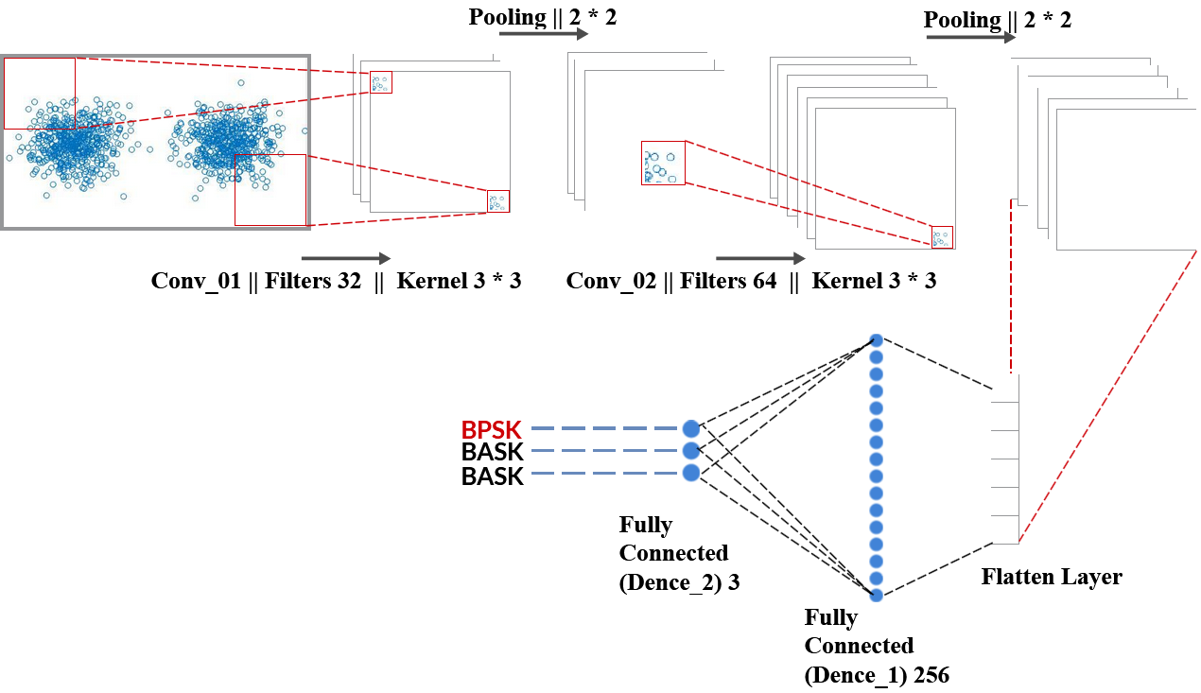
Architecture of the Project
Algorithm

Slide 11
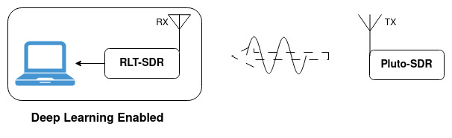
Architecture of the Project
Hardware

Slide 12
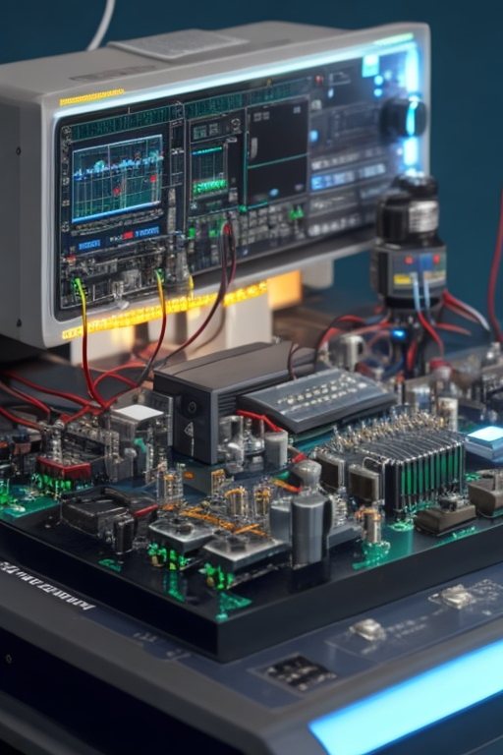
03
Implementation

Slide 13
Progress level of CNN Machine Learning Technique
Test
Train
Valid
Output 1
Output 2
Input 1
Output 3
Input 2
Input 3

Slide 14
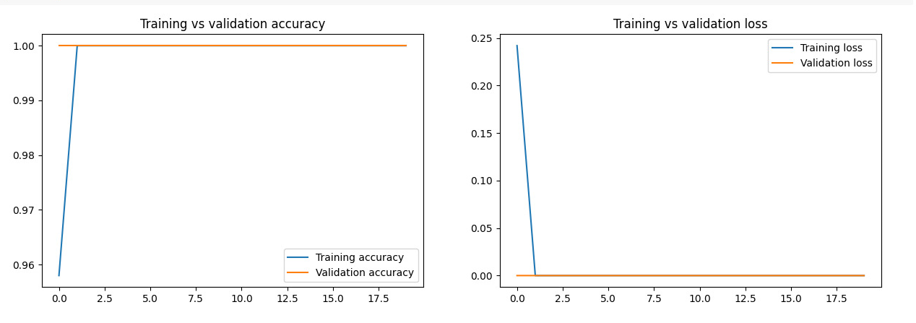
Accuracy Measurement using CNN Algorithm

Slide 15
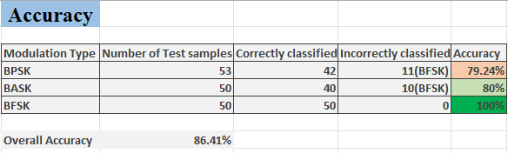
Accuracy Measurement using CNN Algorithm

Slide 16
Progress level of ANN Machine Learning Technique and Hardware
01
Collecting Dataset using MATLAB
02
Get real time Dataset using SDR

Slide 17

Risk Factors
04

Slide 18
Risk Factors and challenges
Continuous improvement
01
Data acquisition
02
Patterns identification
03
Time and resources
04

Slide 19
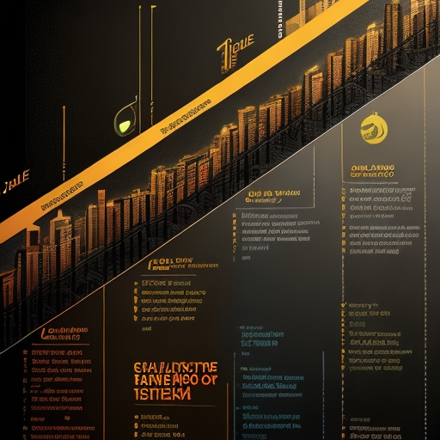
Timeline
05

Slide 20
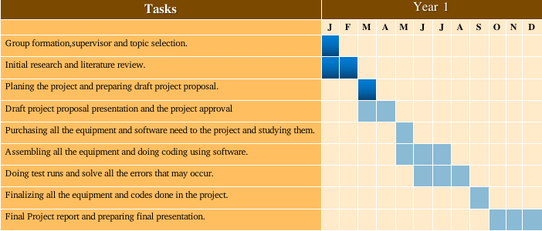
Gantt chart

Slide 21
Any Question ?
Thank You

